Slide 1
SAP Gateway
Day 1
<Trainer>
Capgemini, India

Slide 2
SAP Gateway Day 4 - Agenda
Code Push Down – Data centric approach
Basics of Core Data Services (CDS)
Features & Advantages of CDS Views
CDS View Definition
CDS View with Joins

Slide 3
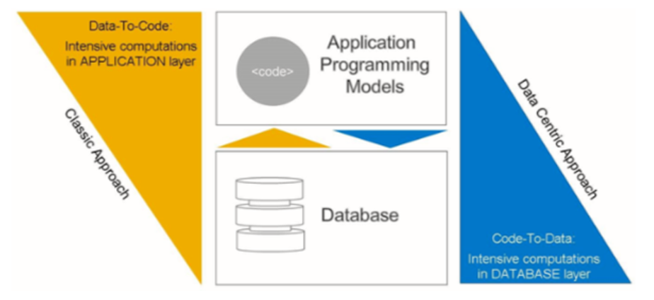
Code Push Down – Data centric approach
The SAP HANA platform combines in-memory software with hardware from leading SAP partners.
Adding SAP HANA technology to certified database hardware enables not only significant acceleration of existing applications, but also the development of completely new applications that were not previously possible.
To leverage the strengths of SAP HANA, applications follow the “code to data” paradigm in which calculation logic is pushed down from the application server to the database server.
The SAP HANA database then performs the calculations and sends the resulting data set back for use by an application.

Slide 4
Introduction to Core Data Services (CDS) View
CDS stands for Core Data Services.
A view is an entity that is not persistent; it is defined as the projection of other entities.
CDS View is reusable data models on the database.
It is a data model that represents framework of what relationships are in a database.
To take advantage of SAP HANA for application development, SAP introduced a new data modeling infrastructure known as core data services.
With CDS, data models are defined and consumed on the database rather than on the application server.
The rule-of-thumb is simple:
Do as much as you can in the database to get the best performance.

Slide 5
Introduction to Core Data Services (CDS) View
A CDS view is defined for existing database tables and any other views or CDS views in ABAP Dictionary .
CDS is a data modeling infrastructure for defining and consuming semantic and reusable data models on the database, rather than on the ABAP server, regardless of the database system used
Technically, it is an enhancement of SQL which provides you with a data definition language (DDL) for defining semantically rich database tables/views (CDS entities) and user-defined types in the database.
CDS entities and their metadata are extensible into the ABAP Data Dictionary and the ABAP language.
Code Push Down – Data centric approach

Slide 6
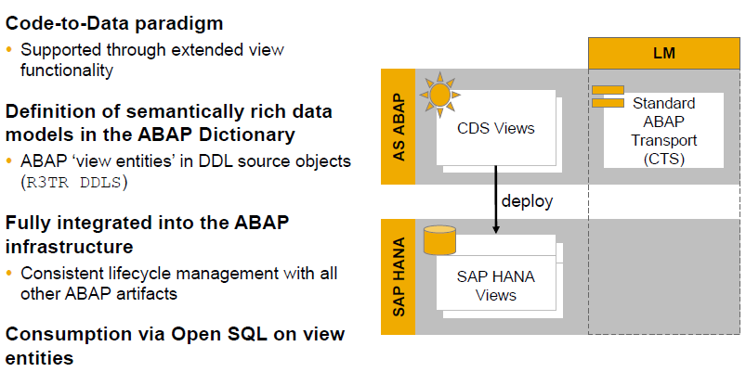
Features of Core Data Services (CDS) View

Slide 7
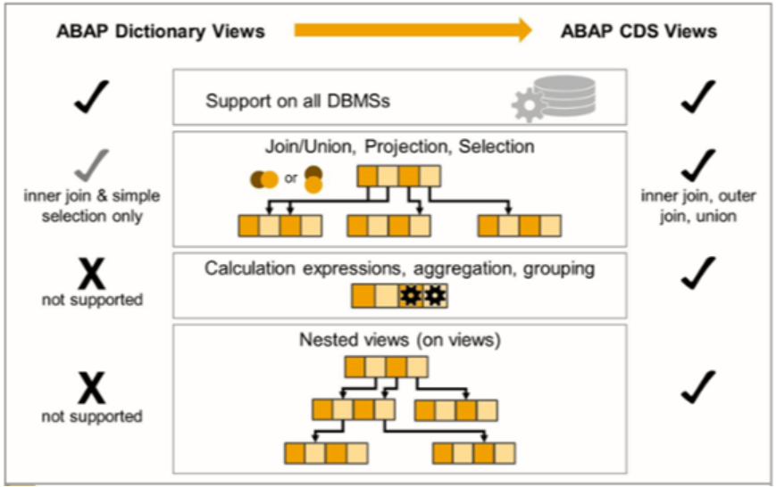
ABAP Dictionary Views vs. ABAP CDS Views

Slide 8
Advantages of CDS
Semantically rich data models
CDS builds on the well-known entity relationship model and is declarative in nature, very close to conceptual thinking.
Compatibility across any database platform
CDS is generated into managed Open SQL views and is natively integrated into the SAP HANA layer.
Efficiency
CDS offers a variety of highly efficient built-in functions — such as SQL operators, aggregations, and expressions — for creating views.
Extensibility
Customers can extend SAP-defined CDS views with fields that can be automatically added to the CDS view

Slide 9
Definition of CDS VIEW
The statement DEFINE VIEW is used to create the CDS DDL in ABAP.
This is done in the CDS source code of a CDS data definition in the ABAP Development Tools (ADT)
Definition is only possible with ABAP Development Tools in Eclipse/HANA
Studio .
CDS view cannot be created via transaction SE11.
CDS views can be developed and maintained in SAP HANA studio and in ABAP in Eclipse

Slide 10
CDS View Definition
Definition of the CDS consists of
View name
Semantic information (key field)
Projection List
Aliases
Projection List :
Client Dependency
Semantic Information (Key)
Aliases
Aggregation
Literals
Arithmetic Expressions
Conditional Expressions

Slide 11
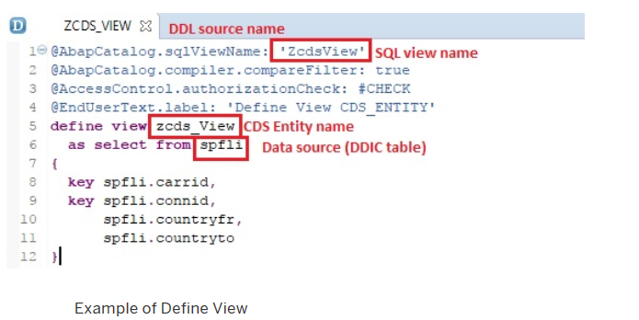
Simple CDS View

Slide 12
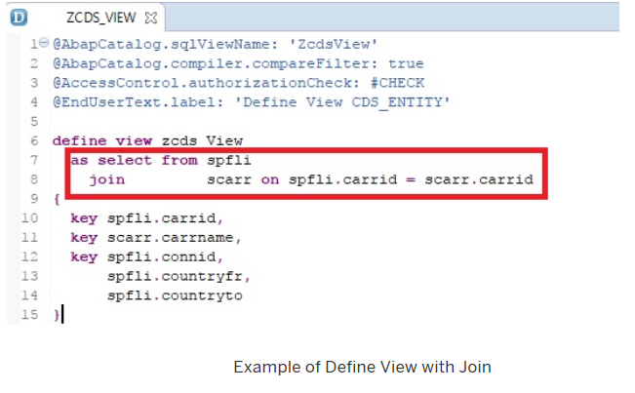
CDS View with Join

Slide 13
Demo
Create Simple CDS View, Preview it and consume it via Open SQL

Slide 14
CDS View Definition
Literal values:
C-sequence literals (Max length: 1333 )
Signed integer literals (4-Byte)
Aggregation functions:
MIN, MAX, COUNT, AVG, SUM
Alias required for function results
String functions:
LPAD,SCORE,LEFT,LTRIM,SUBSTRING
Alias required for function results

